Slide 1
Wifi Details
SSID: RMIT-University
Username: s2984044
Password: wifi4DLTV
Unit 3 - http://bit.ly/1SlAaAc
Unit 4 - http://bit.ly/1MGucIo

Slide 2
Informatics Workshop
Digital Learning and Teaching Victoria

Slide 3
Overview
Key Knowledge & Skills
Sample Timelines
The SAT

Slide 4

DISCLAIMER

Slide 5
FAQs
These are from the DLTV webinar,
the EduLists and offline conversations

Slide 6
Can a student have studied IT Applications this year and study Informatics next year?

Slide 7
Is the SAT for
Informatics a folio task?
How many SAT subjects should my students be limited to?

Slide 8
What does assessment look like in Informatics?
How much time should I allocate in class to the SAT?

Slide 9
What are the main resources I will need?
What software tools
do I need to use?

Slide 10
How do I prepare my students for the exam?

Slide 11

What are your burning Questions?
What are your
burning questions?

Slide 12
Key Knowledge
& Key Skills
What content do I have to teach?

Slide 13

Unit 3
Area of study 1 -
Organisations &
Data Management

Slide 14

Unit 3
Area of Study 2 -
Data Analytics:
Drawing Conclusions

Slide 15

Unit 4
Area of Study 1 -
Data Analytics: Presenting the Findings

Slide 16

Unit 4
Area of Study 2 -
Information Management

Slide 17
Key Knowledge
& Key Skills
What’s new? What’s changed?

Slide 18

What’s new?

Slide 19
Key Concepts
New feature

Slide 20
Approaches to
problem-solving
Data and
information
Computing
Units 1 - 4
Interactions
and impact
Digital
Systems

Slide 21
Unit 3
New terminology & content
Source: VCAA
U3O1 | U3O2
Design principles User flow diagrams | Primary and secondary sources of data Qualitative and quantitative data Coding qualitative data Features of hypothesis Project management processes and concepts Pattern recognition Referencing methods

Slide 22
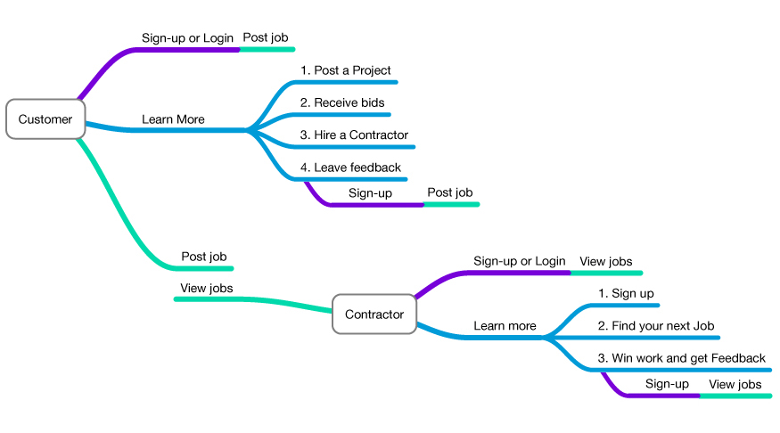
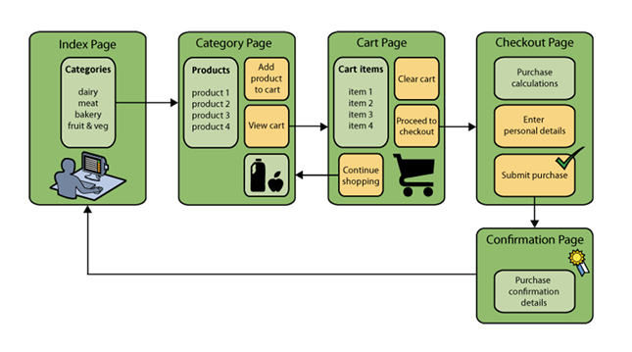
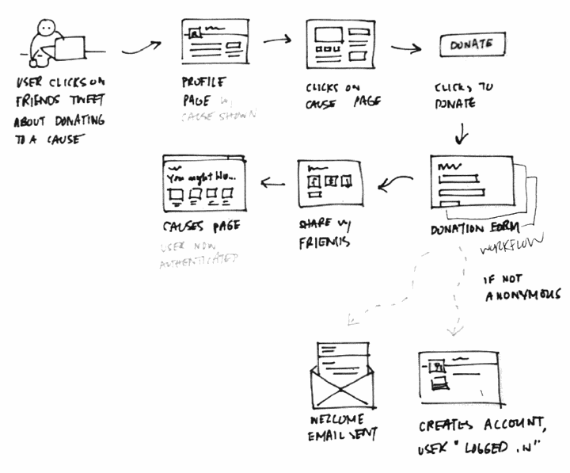
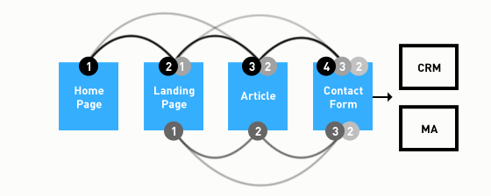
Examples –
user flow diagrams
Source: Robert Timmer-Arends & VCAA
http://gauravpanchal.stuntnyc.com/wp-content/uploads/2013/07/builderbuzz_mindmap_2.jpg
https://netbeans.org/kb/docs/javaee/ecommerce/design.html
https://www.newfangled.com/how-to-tell-the-users-story
http://zurb.com/word/information-architecture
http://gauravpanchal.stuntnyc.com/wp-content/uploads/2013/07/builderbuzz_mindmap_2.jpg
Notes:
It is important to stress that VCAA is not mandating the style of user flow diagram. However a short list of functions for the graphics software will be published in the VCAA Bulletin in Term 4.
The important point is that the diagram clearly shows the points/stops where data is entered in order to complete a transaction – the data flow. It is also essential that students use software to represent the user interface on the page on which the user commences an online transaction.

Slide 23
Unit 4 –
New terminology & content
U4O1 | U4O2
Techniques for generating design ideas Effective multimodal online solutions Design principles | Reasons for information management strategies
Source: VCAA

Slide 24
Implementation
Conversation Topic
How would I implement these units if I was
teaching Informatics next year?
Unit 3 - http://bit.ly/1SlAaAc
Unit 4 - http://bit.ly/1MGucIo
Must open in Chrome to contribute

Slide 25
Assessment
Study wide changes

Slide 26
Assessment Structure
U3 O1
10% Study Score
U3 O2
SAT
U4 O1
SAT
U4 O2
10% Study Score

Slide 27
“To study and use” or “To use”
What’s changed?
Software Tools

Slide 28
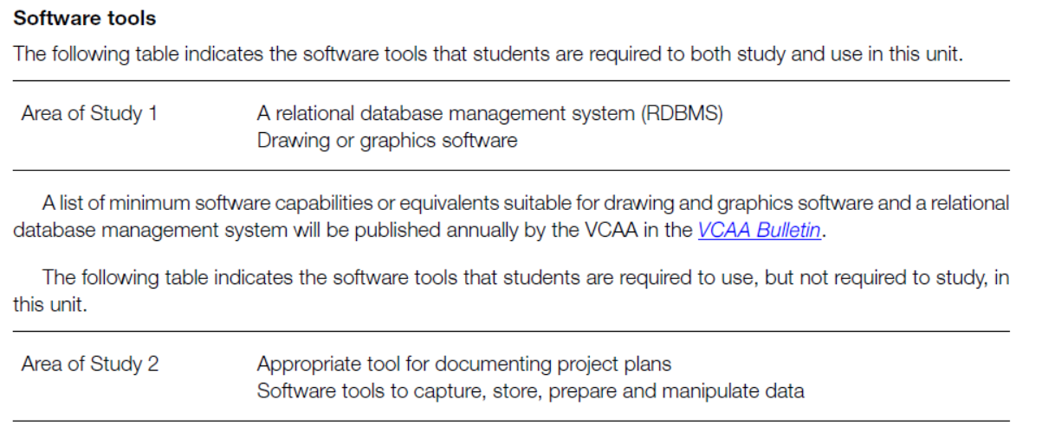

Slide 31
Sample Timelines
What works for my classroom may not work for yours

Slide 32
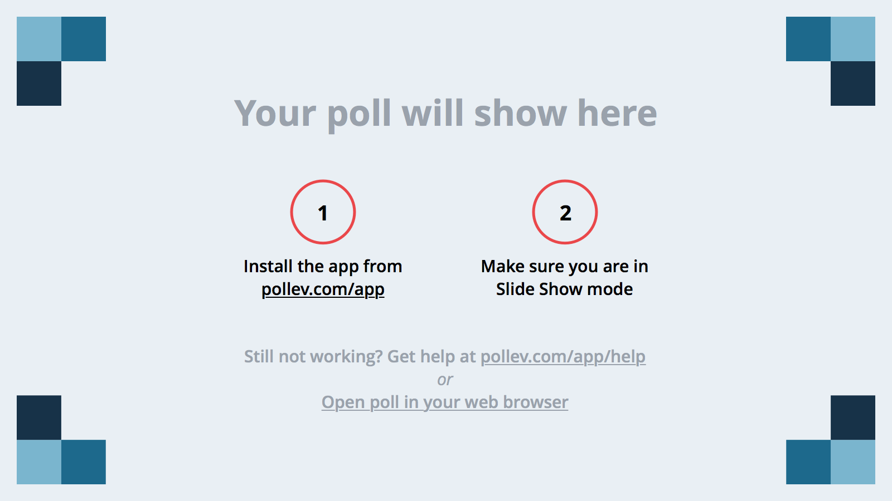
Notes:
Poll Title: Which approach are you going to take?
https://www.polleverywhere.com/multiple_choice_polls/IdlwZZC2afV7OS9

Slide 33
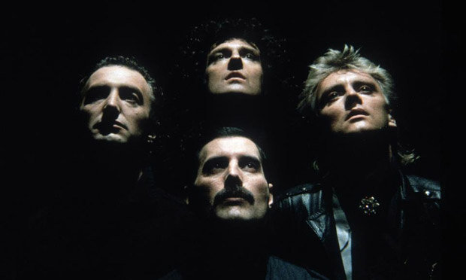
The School
Assessed Task
Thunderbolts of lightning,
very very frightening.
(Not really…)

Slide 34
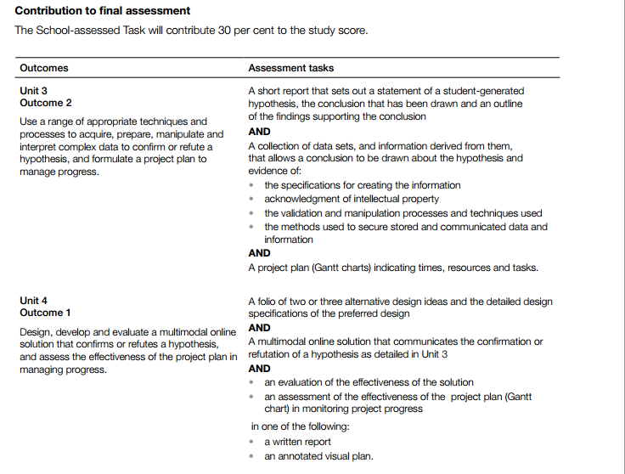
SAT Requirements

Slide 35
Supplementary
SAT information
Digital document

Slide 36
Informatics Assessment
(SAT Highlighted)
 | Informatics U3 | Informatics U4
O1 | Database solution & user flow diagram | Design ideas Multimodal online solution
O2 | Investigation of hypothesis Data sets & derived information Project plan | Information management analysis

Slide 37
With the hypothesis, does the student have to confirm it to get full marks?
No. Students can either confirm or
refute the hypothesis and still receive full marks.

Slide 38
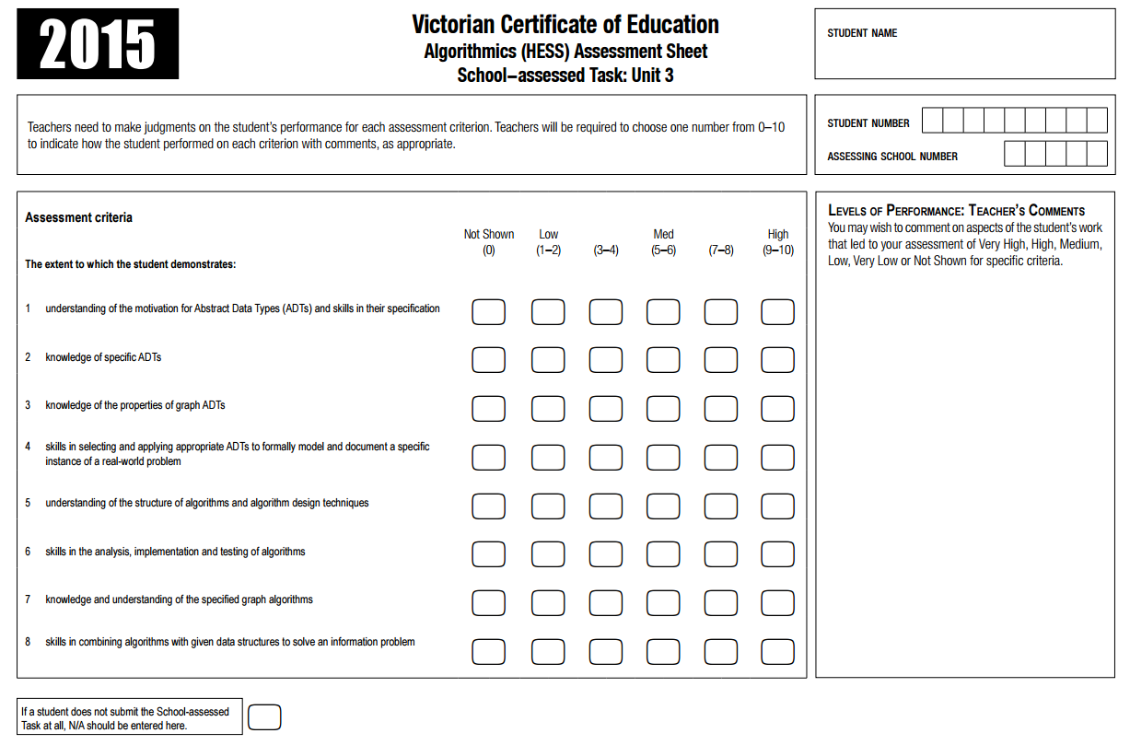
Algorithmics:
Criterion example
Notes:
This is the 2015 Algorithmics SAT Assessment sheet.
Each criterion must be assessed using the provided performance descriptors.

Slide 39
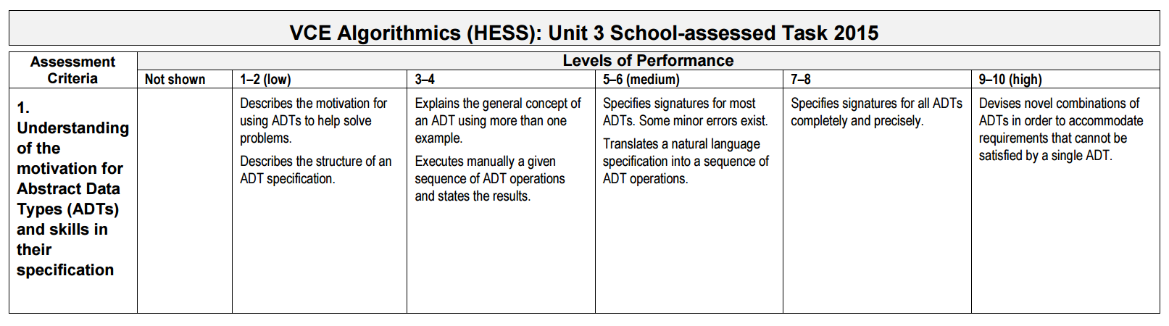
Algorithmics:
Performance descriptors example
Notes:
Example of the criterion that are to be used in marking the SAT.
VCAA Policy states that criterion used to assess students is not to deviate from this in order to ensure some consistency in marking the SATs across the state.

Slide 40
What structures can I put in place for my students in regards to the SAT?

Slide 41
What if a student loses their SAT?
What if I lose a student’s SAT?
Notes:
From the Admin Handbook 2015:
A student who uses a computer to produce work for assessment is responsible for ensuring that:
• there is an alternative system available for producing assessable work in case of computer or printer malfunction or unavailability
• hard copies of the work in progress are produced regularly
• each time changes are made, the work is saved as a backup file, which should not be stored on the computer.
Our understanding from this is that if the student does not take the appropriate care for their files then they are graded only for what work they are able to produce within the given timelines.
Students should also therefore retain all relevant files until such time they receive their results in December.

Slide 42
Informatics SAT Training Day
Provided by VCAA
VCAA Coburg
Date: 22nd February 2016
COMPLETELY FREE
(apart from transport to/from the event)

Slide 43
The SAT
Conversation Topic
What does the SAT look
like for you?
What ideas do you have around
the implementation of the SAT?

Slide 44
What are your burning Questions?
What are your
burning questions?

Slide 45
The Edulists
www.edulists.com.au → Mailing List → Subscribe to Informatics

Slide 46
Thanks for your time
Feel free to contact me via jvella@mackillop.vic.edu.au

